Slide 1

Xunit Testing in .NET
An Introduction to Unit Testing with Xunit
Presented By: Purvesh Sanagni Ronak Pethani

Slide 2
Agenda
Introduction to Unit Testing
Overview of Xunit
Setting Up Xunit in a .NET Project
Writing and Running Tests
Assertions in Xunit
Mocking Dependencies
Best Practices
Q&A

Slide 3
Introduction to Unit Testing
Purpose: Ensure individual components work as expected.
Benefits:
Early bug detection
Improved code quality
Improved code quality
Types: Unit testing vs. Integration testing vs. End-to-End testing

Slide 4
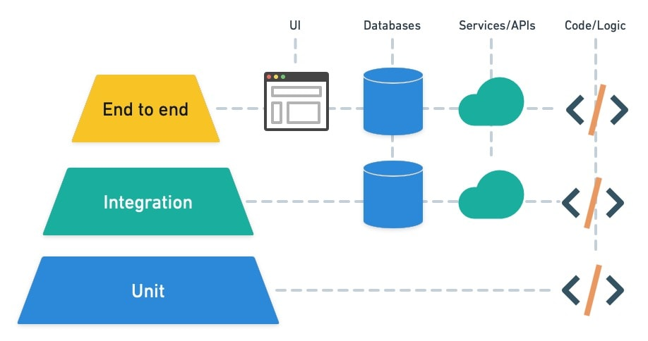
The Testing Pyramid

Slide 5
Overview of Xunit
What is Xunit? A popular .NET testing framework.
Key Features:
Lightweight and extensible
Supports parallel test execution
Easy to use assertions and test cases

Slide 6
Setting Up Xunit in a .NET Project
Prerequisites: .NET SDK, IDE (e.g., Visual Studio)
Steps:
Install Xunit via NuGet
Add Xunit NuGet package
Configure Xunit in the project file

Slide 7
Writing and Running Tests
Creating Test Classes and Methods:
Use [Fact] for simple tests
Use [Theory] for parameterized tests
Running Tests:
From Visual Studio (Test Explorer)
From Command Line (dotnet test)

Slide 8
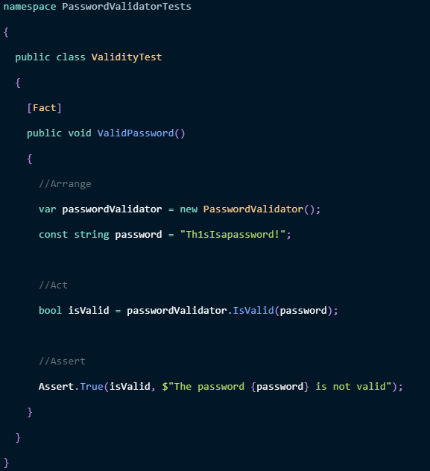
Assertions in xUnit(AAA)
Arrange. With this action, you prepare all the required data and preconditions.
Act. This action performs the actual test.
Assert. This final action checks if the expected result has occurred.

Slide 9
Mocking Dependencies
What is Mocking?
Simulating dependencies to isolate the unit being tested
Using Moq Framework

Slide 10
Best Practices
Write Meaningful Tests:
Clear and descriptive test names
Keep Tests Independent:
Avoid dependencies between tests
Test Coverage:
Aim for high coverage but prioritize critical paths
Continuous Integration:
Integrate tests into CI/CD pipelines

Slide 11
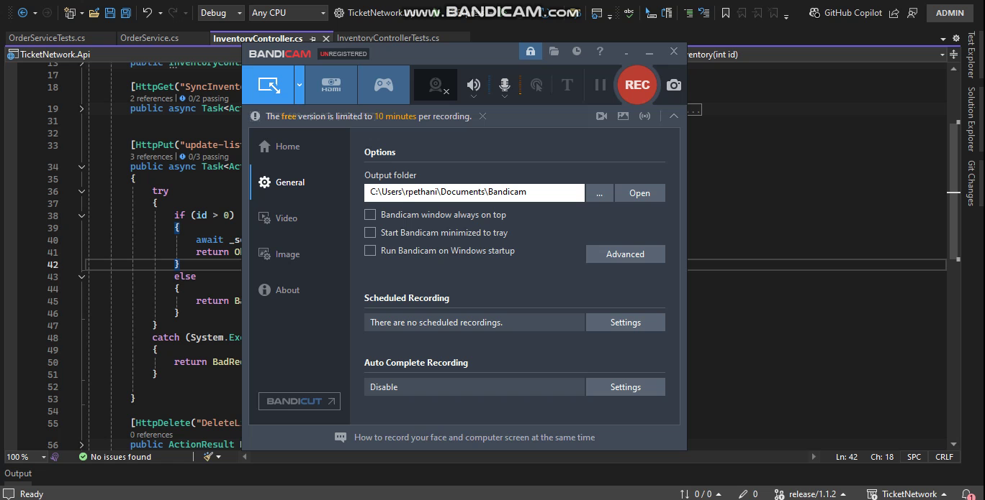

Slide 12
?

Slide 13
Thank You

